Slide 1
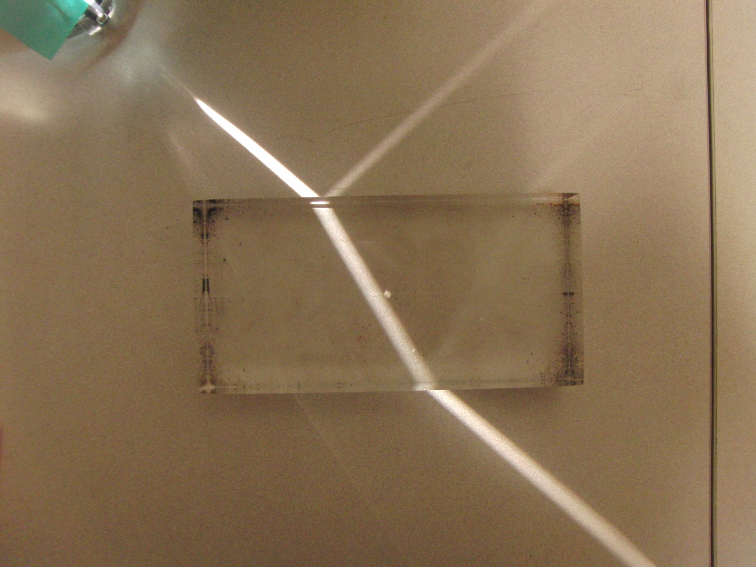

Slide 2
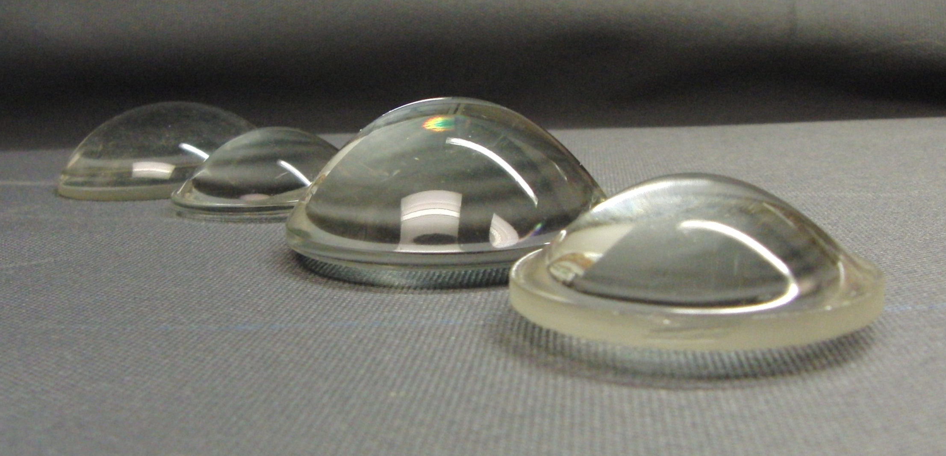

Slide 3
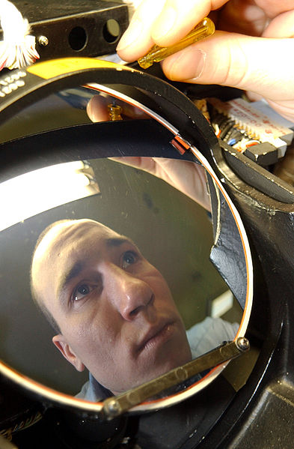

Slide 4
Incident Ray
Reflected Ray
θ₁
θ₃
Air
Fast
n₁ (Small)
Glass
Slow
n₂ (Large)
θ₂
Transmitted Ray

Slide 6
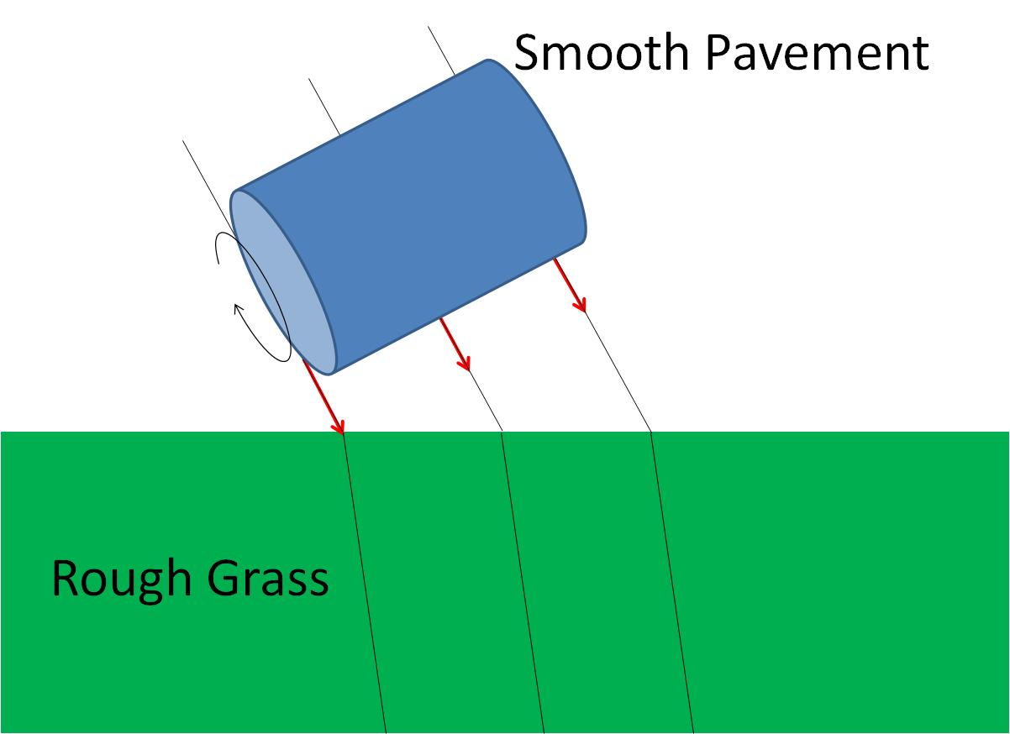
Smooth Pavement
Rough Grass

Slide 7
Smooth Pavement
Rough Grass

Slide 8
Smooth Pavement
Rough Grass

Slide 9
θ_{i}
θ_{t}

Slide 10
θ
φ

Slide 11
Transmitted Ray
θ₂
Air
Fast
n₂ (Small)
Glass
Slow
n₁ (Large)
θ₁
θ₃
Incident Ray
Reflected Ray

Slide 12
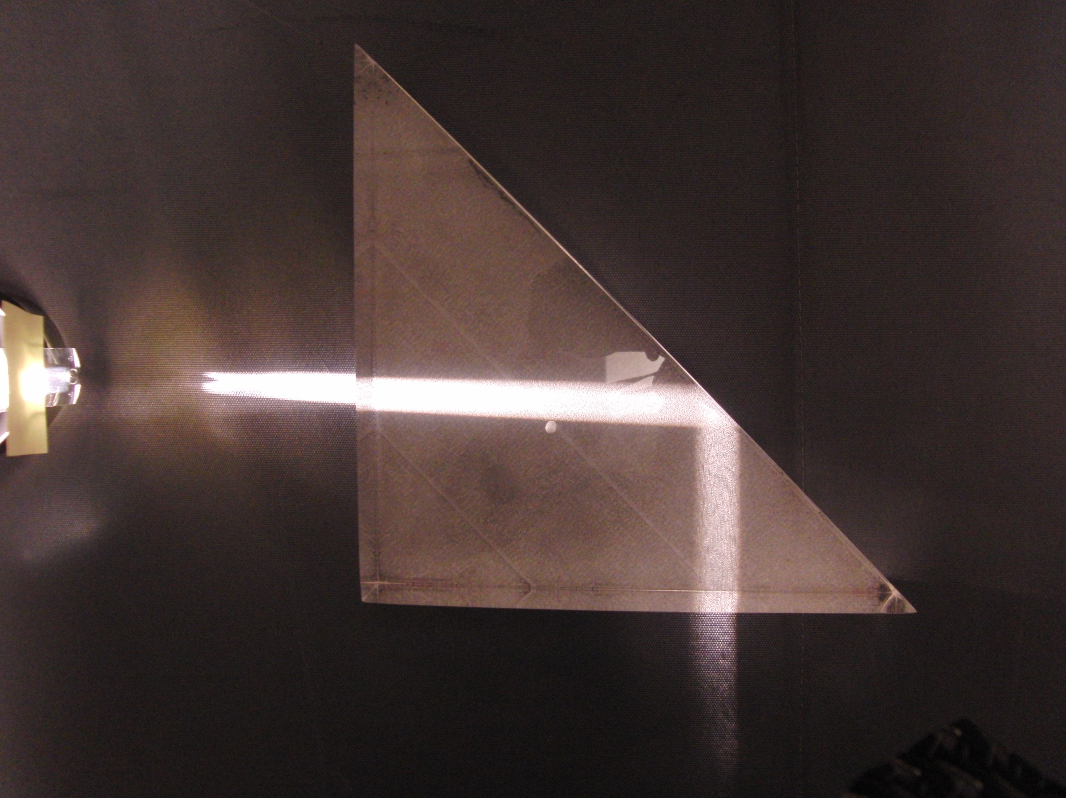

Slide 13
Fast
n₂ (Small)
Slow
n₁ (Large)
θ_{c}
Source

Slide 14
θ_{t}
θ_{c}
θ_{i}

Slide 15
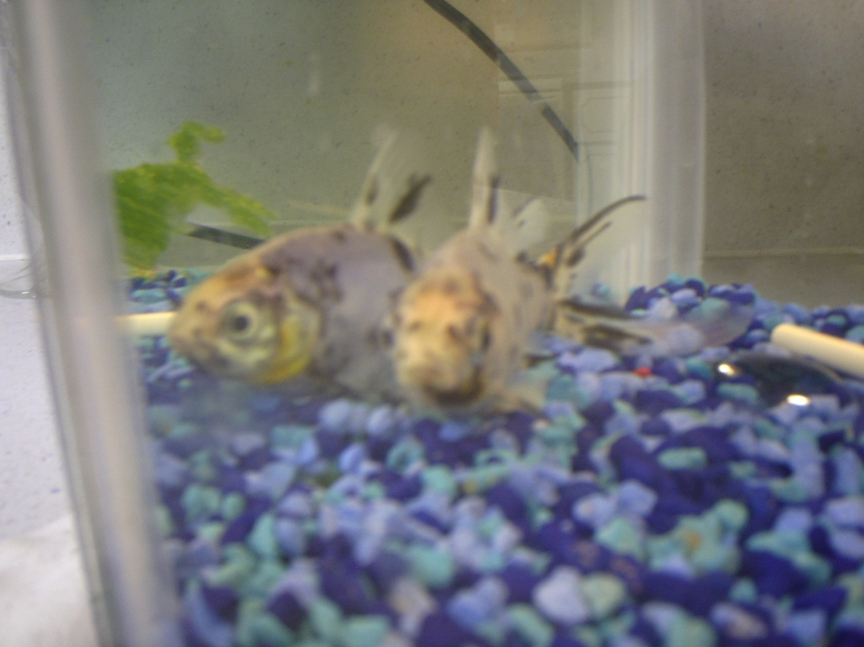

Slide 16

Image courtesy US Navy: http://commons.wikimedia.org/wiki/File:US_Navy_120208-N-TS452-068_Mass_Communication_Specialist_1st_Class_Jayme_Pastoric_trains_Mass_Communication_Specialist_3rd_Class_Scott_Raegan,_a_ne.jpg

Slide 17
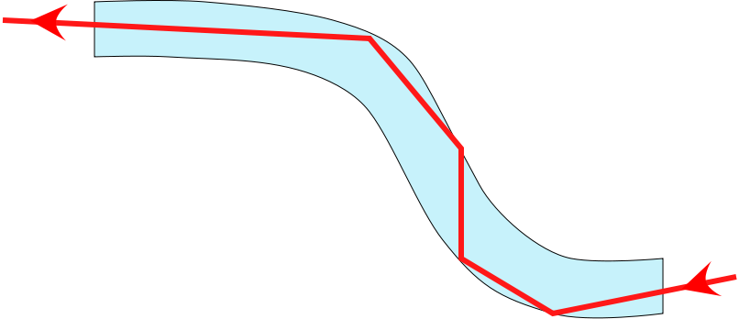
Fiber Optics

Slide 18
Fiber Optics

Slide 19
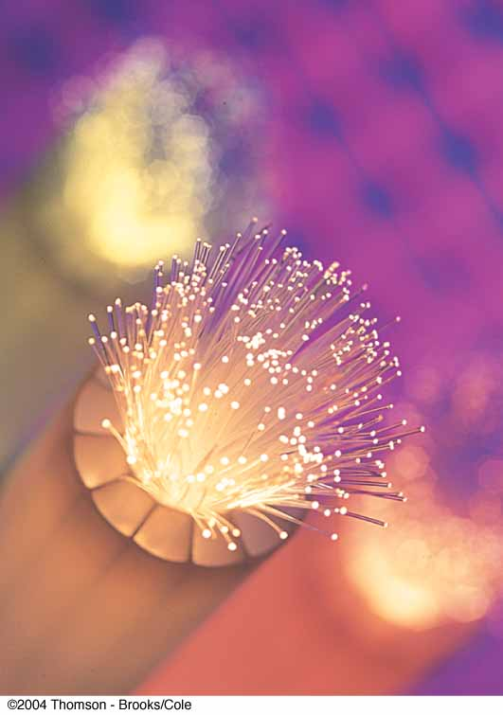
Fiber Optics, cont.
A flexible light pipe is called an optical fiber
A bundle of parallel fibers (shown) can be used to construct an optical transmission line

Slide 20
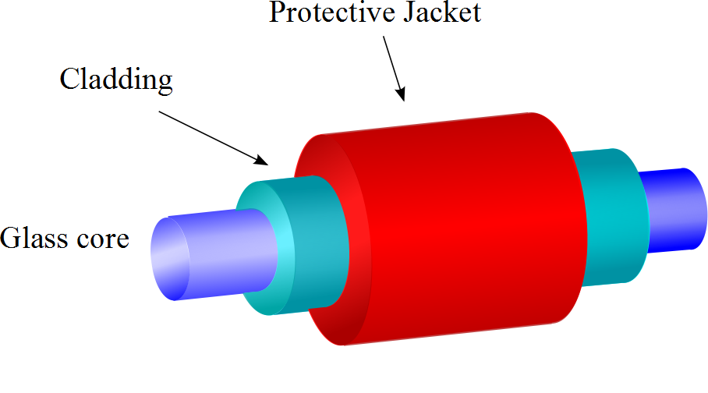
Construction of an Optical Fiber
The transparent core is surrounded by cladding
The cladding has a lower n than the core
This allows the light in the core to experience total internal reflection
The combination is surrounded by the jacket

Slide 21
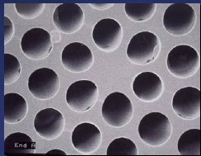
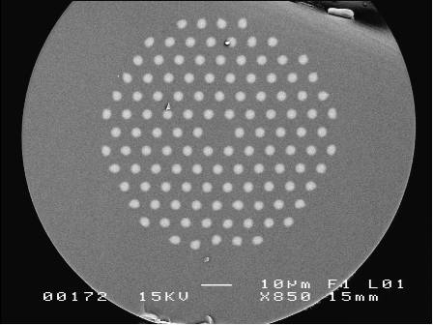
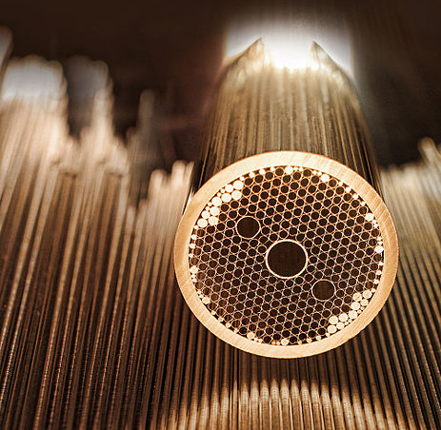
Modern Hollow-Core Fibers
Figure 2. Solid photonic bandgap fibre with isolated high-index cladding rods and a low-index core..
Solid photonic bandgap fibre with isolated high-index cladding rods and a low-index core. (J. C. Knight, "Origins and limitations of photonic bandgap guidance in optical fibres", photon06.org/Microstructured%20photonic%20materials%20Wed%20%2010.15.doc)
Hollow-Core Fiber (Courtesy Defense Advanced Research Projects Agency (DARPA), image in the public domain)

Slide 22
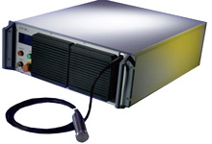
Example: Fiber Lasers
IPT Photonics YLR- LP Series: 10 to 500W Single Mode Linearly Polarized Ytterbium Fiber Lasers
Main Features:
1060 to 1070nm Wavelength Range
Extinction Ratio &gt;20dB
TEMoo (M2&lt;1.1)
Air or Water Cooled Versions
100,000 hours Est. Pump Diode Lifetime
Maintenance Free Operation
Single Mode Fiber Delivery
Applications:
Materials Processing
SHG
Medical
Scientific

Slide 23
Lens
Image
Light Source

Slide 24
Fish out of water
Rays from fish head
Eyes
d
Rays from fish tail

Slide 25
Fish out of water
Rays from fish
Eyes
d
Rays from fish
Fish in water
Image of Fish
Rays appear to come from here
d’

Slide 26
s
s’
Rays from fish
Fish in water
ℓ
Image of Fish
θ₂
θ₁
ℓ
θ₁
θ₂
Rays appear to come from here
n₁ (Large)
n₂ (Small)

Slide 27
Object
[Figure]
Convergence Point

Slide 28
A
θ_{i}
θ_{t}
η
S
d
P
α
β
γ
V
C
R
s_{o}
s_{i}

Slide 31
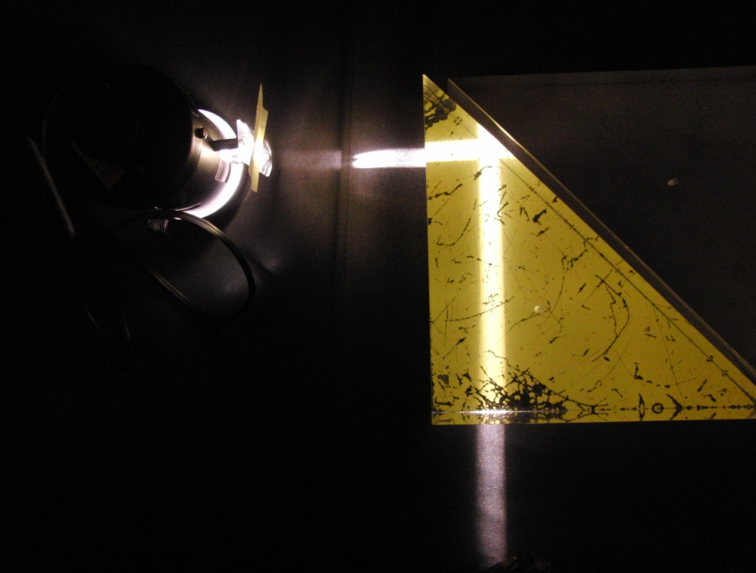
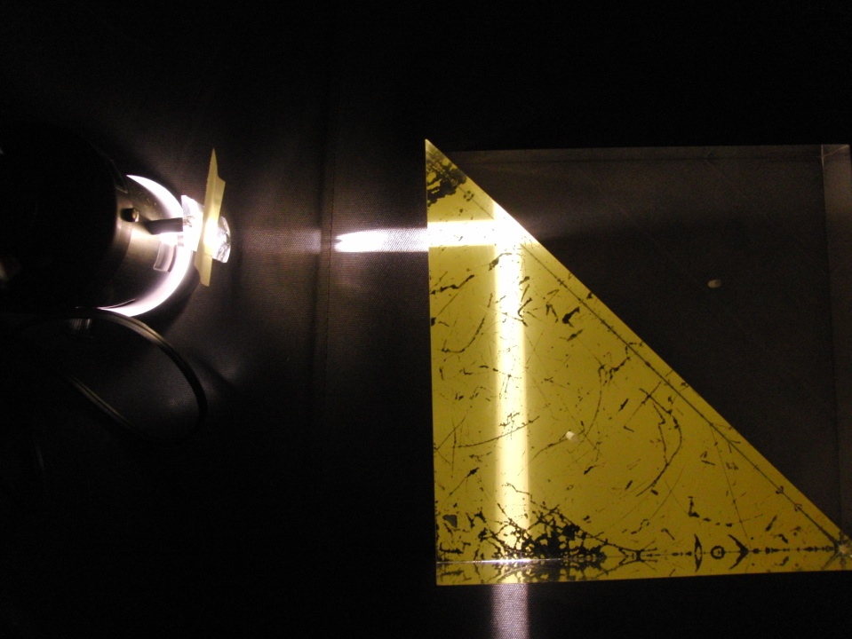
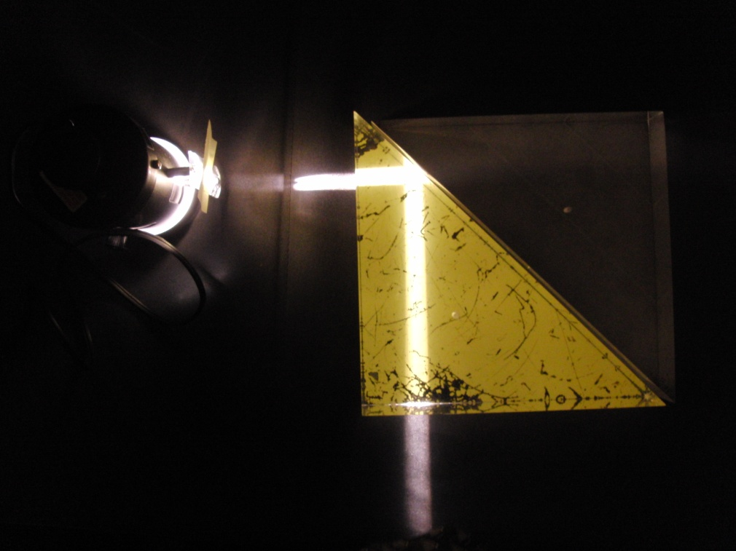
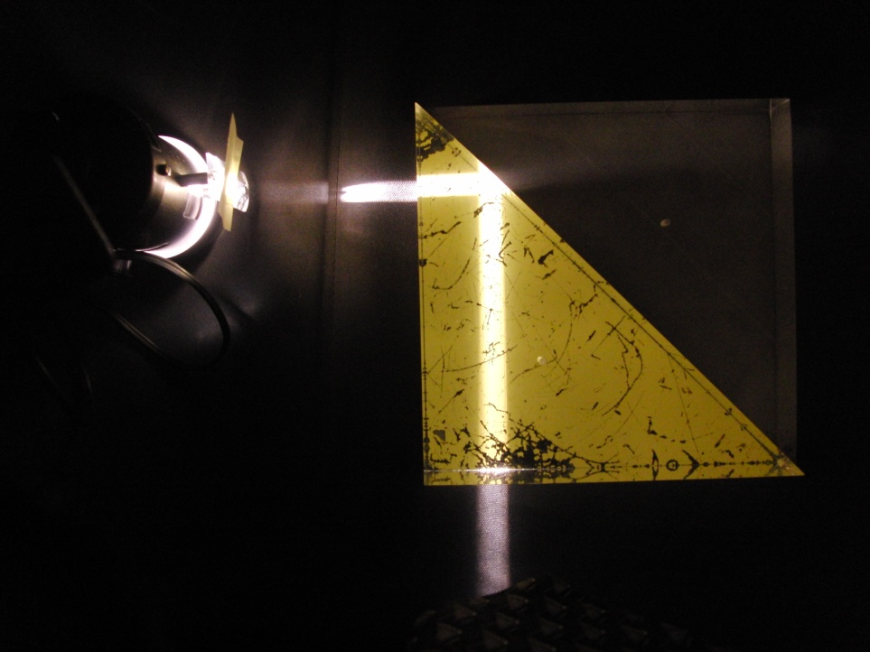
(a)
(b)
(c)
(d)

Slide 32
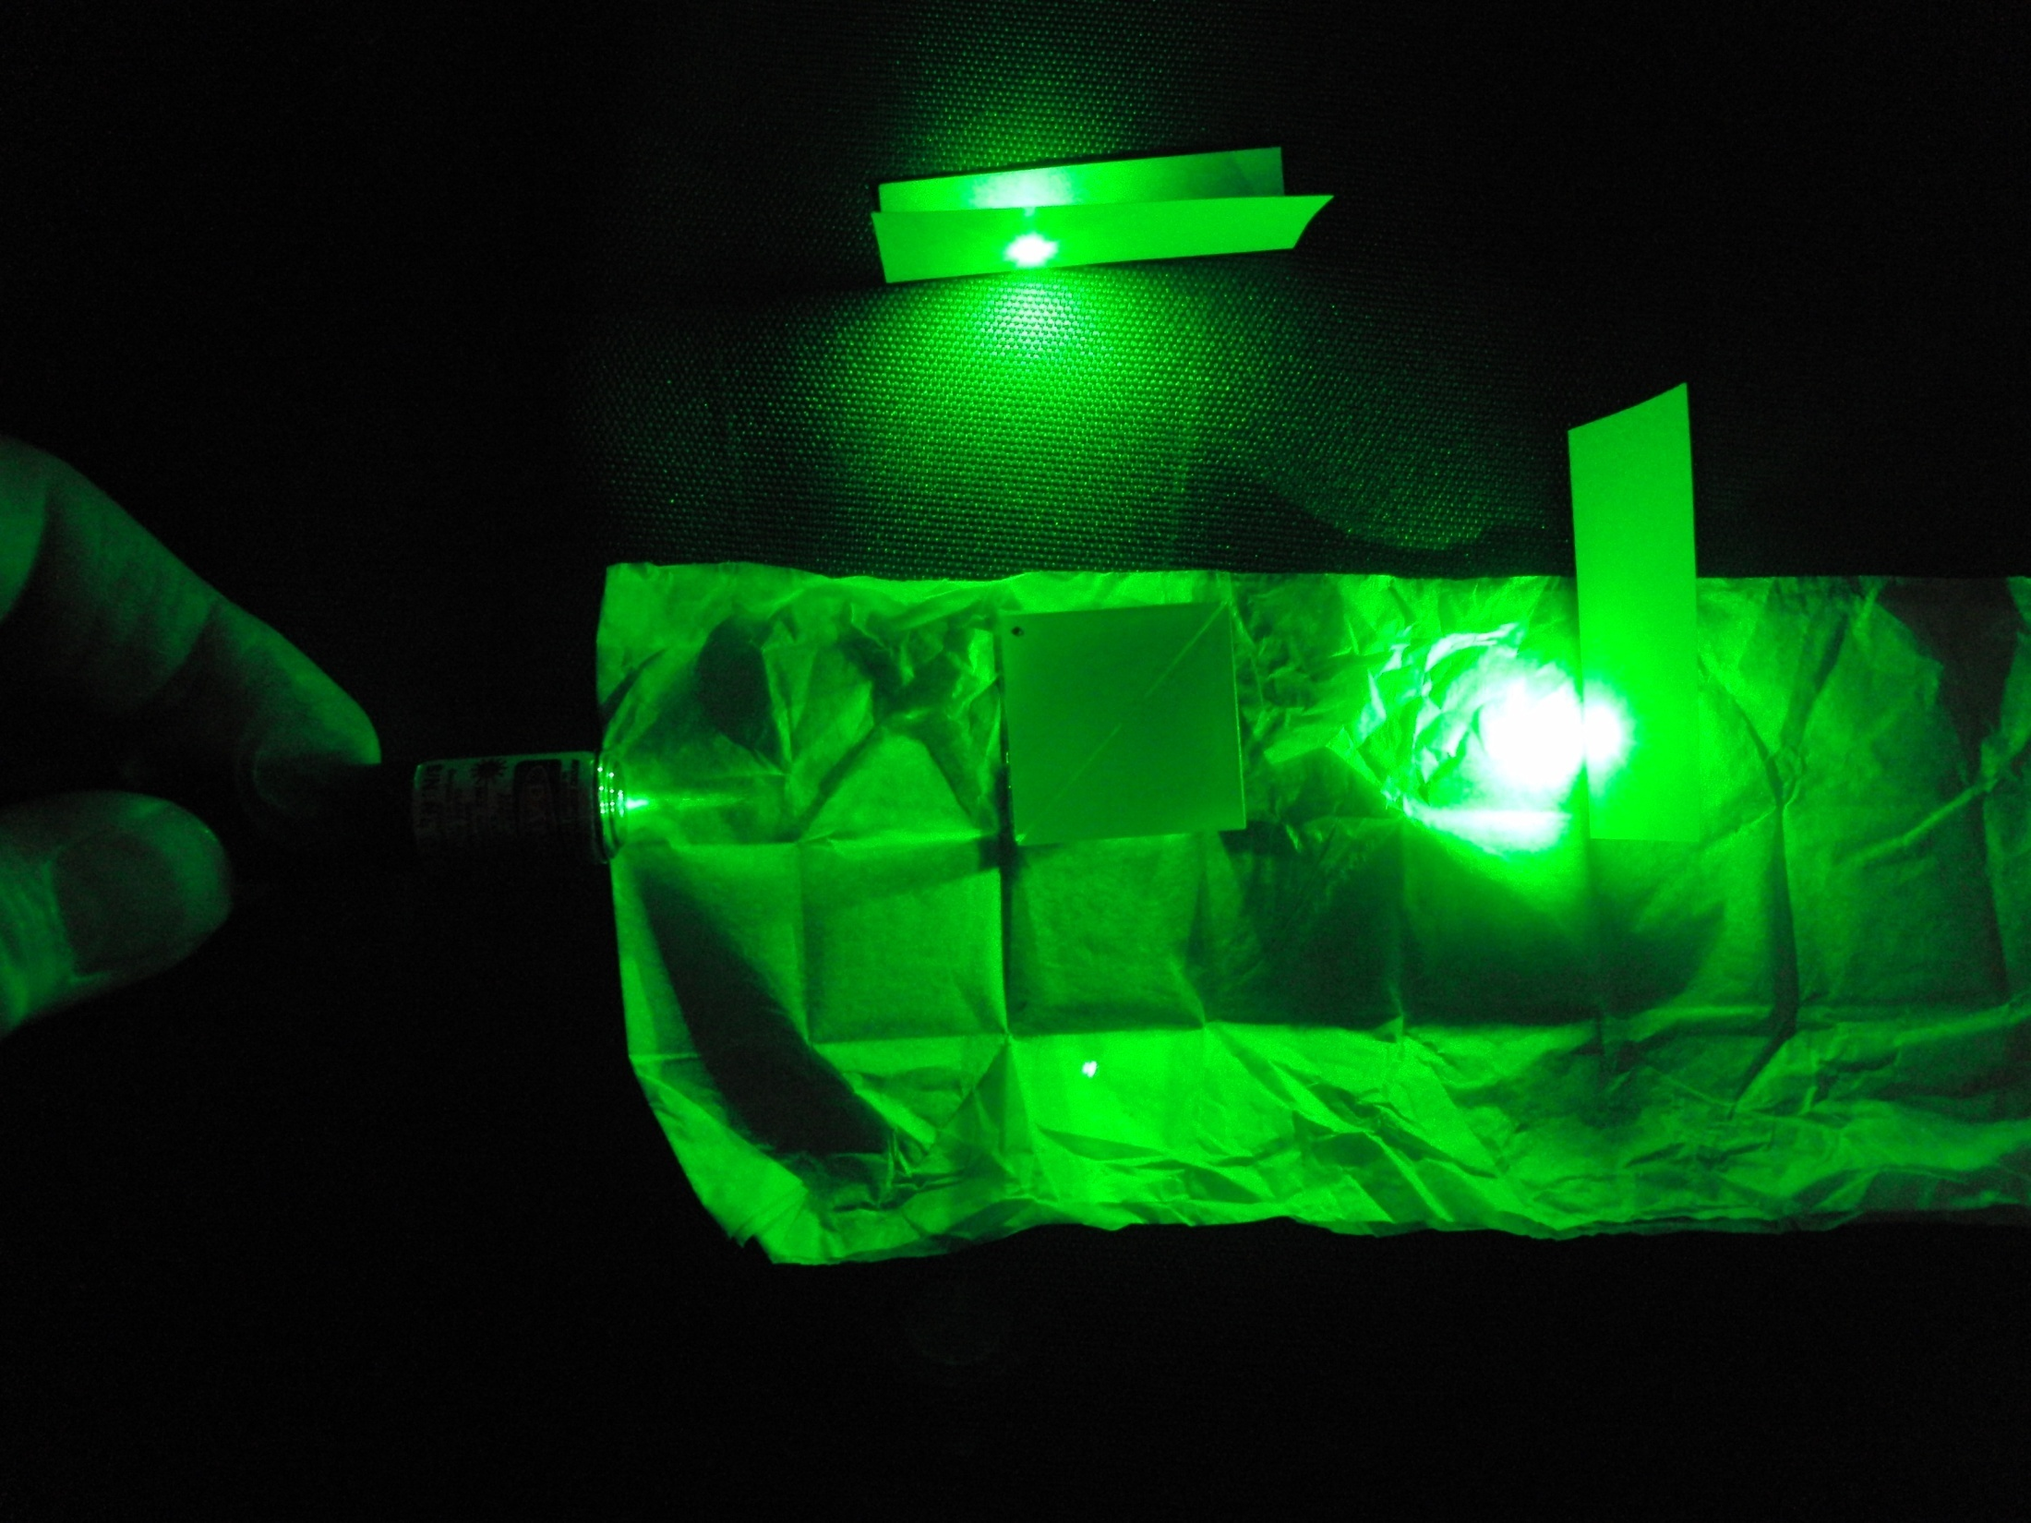
Internally Reflected Beam
Beam Splitter
Laser Pointer
Frustrated Total Internal Reflection Beam

Slide 33
